Slide 1


Statistical Soundness vs.
Statistical Significance
Scalable Summary Operations, Hypothesis Testing at Scale, and Practical Impact for Modern Data Science

Slide 2

Scalable Summary Operations
1. Relational Summaries
2. Approximate Algorithms
Compute Where Data Lives: Packages like dbplyr and duckdb translate R code into optimized SQL queries.
HyperLogLog (HLL): Estimates unique counts (n_distinct) across 100M+ rows in milliseconds with <1% error.
Lazy Evaluation: Aggregations execute directly on database backends, preventing R memory crashes (`vector memory exhausted`).
t-Digests: Approximates percentiles and medians without requiring massive array sorting in RAM.

Slide 3

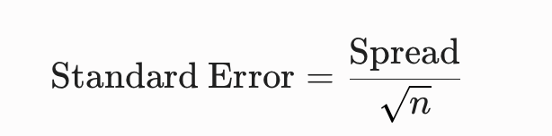
The p-Value Paradox
In Big Data, as sample size N to infinity, standard error drops to zero:
The Super-Magnifying Glass Effect: With millions of records, standard errors collapse. Even a tiny, meaningless $0.0001
difference yields p < 0.0001.

Slide 4






The Three Pillars Framework
1. Significance
2. Soundness
3. Practicality
Question: "Is this difference real or random noise?"
Question: "Are our test and data fair and unbiased?"
Question: "Does the size of the difference matter?"
Determined by $p$-values. In Big Data, almost everything becomes statistically significant.
Checks experimental design, independence, and sampling integrity. Bad data gives high confidence in wrong answers.
Measures Effect Size (Cohen's $d$, $95\%$ CIs, ROI). Independent of sample size $N$.

Slide 5
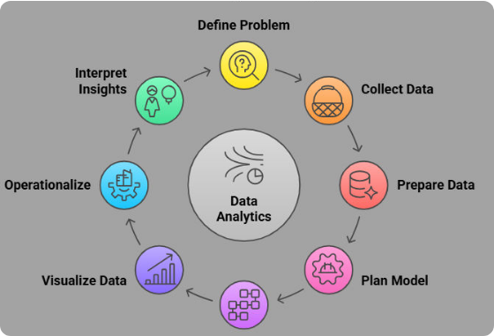
Significance vs. Practical Impact
•
p-Values Ignore Magnitude: A feature shift from $10.00 to $10.01 gives p < 0.0001 at N = 10M, but adds no real revenue.
•
Focus on Effect Sizes: Report standardized metrics (Cohen's d) and absolute lifts alongside 95% Confidence Intervals.
•
Business ROI Rules: If server costs to deploy a feature exceed financial gains, the result lacks practical significance.

Slide 6
Ensuring Statistical Soundness
Beware Sampling Bias: 10 million rows of biased data just yields 100% confidence in a wrong conclusion.
Validate Modeling Assumptions: Verify independence of observations, check for autocorrelation, and use cluster-robust standard errors.
Perform Subsampling Checks: Compare results from $N = 10,000,000$ against stratified samples of $N = 5,000$ to observe parameter stability.
Audit Data Pipelines: Ensure no data leakage or aggregation artifacts contaminate summary metrics.

Slide 7
Imagine you built a Robot Dog Finder camera. You take it to the park to find dogs in photos.
1. Accuracy (The Big Picture Score)
What it asks: "Out of ALL photos the robot checked, how often was it right overall?"
How it works: It counts every photo where the robot was correct—both when it correctly spotted a dog AND when it correctly realized a photo was not a dog.
The Catch: If you have 99 cats and 1 dog, a lazy robot that screams "NO DOG" every single time is 99% accurate, but it’s completely useless at finding dogs!
2. Precision (Avoiding False Alarms)
What it asks: "When the robot shouts 'I found a dog!', how often is it ACTUALLY a dog?"
How it works: Think of this as quality over quantity. If the robot points at 5 animals and shouts "DOG!", and 4 are real dogs while 1 is actually a fluffy cat, its Precision is 4 out of 5 (80%).
High Precision means: Very few false alarms!
3. Recall (Catching Everything)
What it asks: "Out of ALL the real dogs hidden in the park, how many did the robot actually find?"
How it works: Think of this like hide-and-seek. If there are 10 real dogs hiding in the park, and the robot successfully finds 8 of them (and completely misses 2), its Recall is 8 out of 10 (80%).
High Recall means: Very few missed targets!

Slide 8
Big Data R Ecosystem & Tools
Analytics Phase | R Package / Tool | Core Function & Benefit
Out-of-Core Processing | duckdb / arrow | Process multi-GB Parquet/CSV files without loading full datasets into RAM.
Scalable Summaries | dbplyr | Translates dplyr syntax directly into optimized SQL engine execution plans.
Effect Size & Testing | effectsize / broom | Calculates Cohen's $d$, $95\%$ Confidence Intervals, and tidy model summaries.
Big Data ML | sparklyr | Fits distributed machine learning models over Spark clusters at scale.

Slide 9



Golden Rules for Data Scientists
Three core principles for evaluating Big Data statistical results
01
02
03
Check Soundness First
Never Trust p Alone
Demand Practical Impact
Garbage in, garbage out. Validate sampling fairness and data pipeline integrity before running any test.
In Big Data, $p < 0.05$ is an engineering byproduct of large $N$. Always demand Effect Sizes & Confidence Intervals.
Statistical significance proves a difference exists; Practical significance proves anybody should care.

